Slide 1
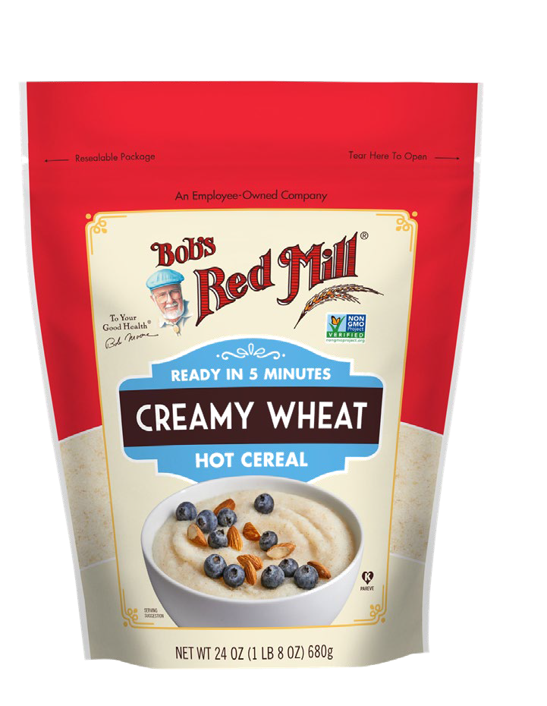
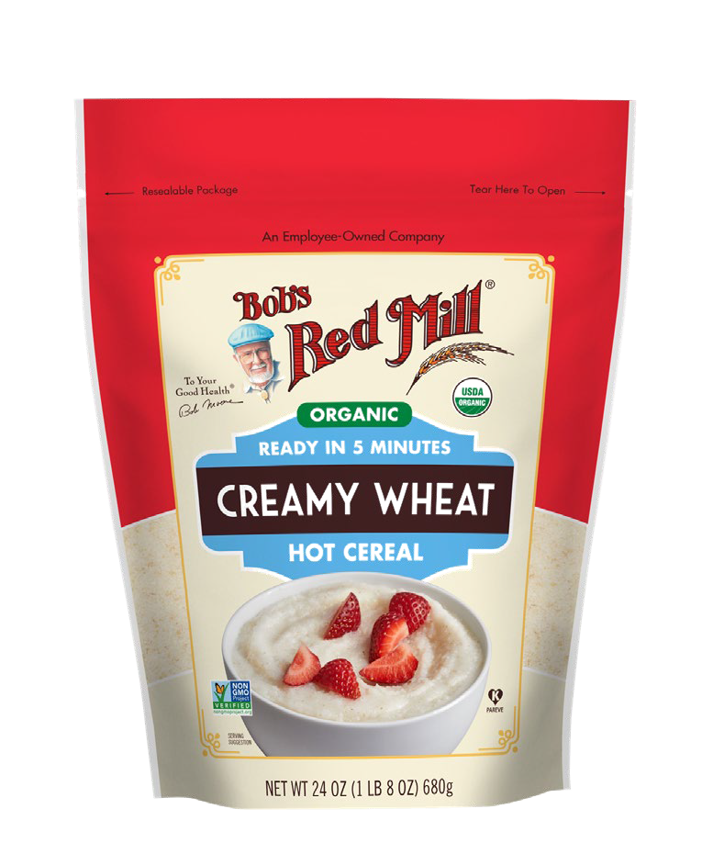




Bob’s Creamy Wheat Farina Will Give Consumers a
Natural Option
BRM’s Creamy Wheat Farina offers consumers a Natural switch from Cream of Wheat 28oz
The Cream of Wheat 28oz SKU is currently performing well at Total US – Food with dollar growth of +23.1%
  Bob’s Red Mill Hot Cereal is outpacing Cream of Wheat by 15.7% and gained +$4.2MM
more in the last year
In Total US BRM’s SKU would do about 5% of Cream of Wheat’s SKU if it reaches the distribution of BRM’s top Hot Cereal SKU, which means it would bring in around $1.6MM
This would make our Creamy Wheat Farina the #31 Natural Hot Cereal SKU in Total US and Bob’s #14 in the Category
$ Change vs YA
Short, simple, clean ingredients list
Smooth & satisfying texture Non-GMO Project Verified Kosher
Re-sealable package
+29.4%
Total US - Food
$11.3MM
+13.7%
$7.1MM
SOURCE: SPINS, TPL, SS HOT CEREAL, TOTAL US - FOOD, LATEST 52 WEEKS, WE 9/6/20
34
BOB'S RED MILL
CREAM OF WHEAT

