Slide 1
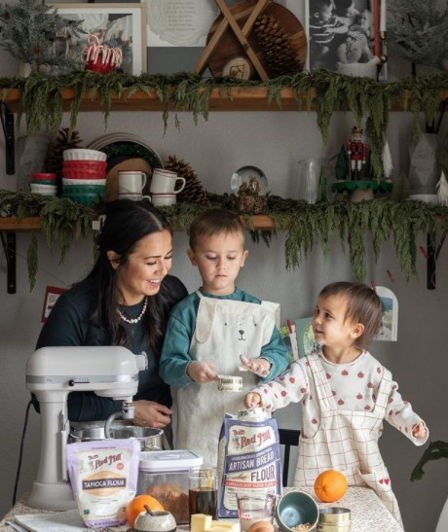
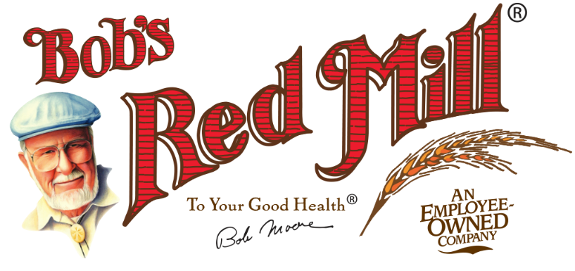
Welcome to Bob’s Red Mill

Slide 2

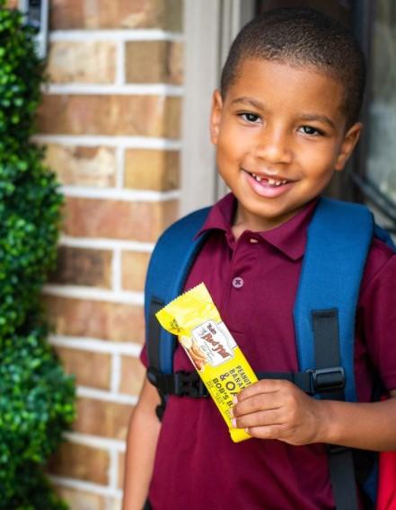
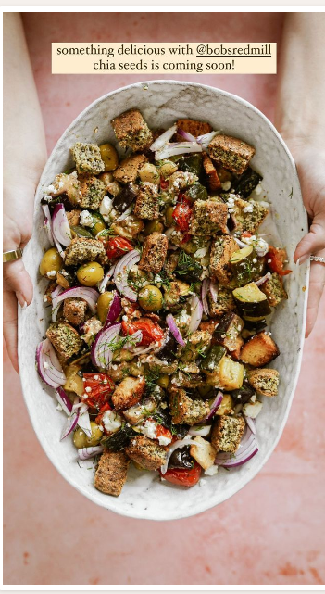
Inspiring Joy With Wholesome Foods
Bob Moore and his wife, Charlee, founded Bob’s Red Mill in 1978 with the mission of providing wholesome foods to folks around the world—while treating everyone with respect. Today, we’re proudly 100% employee owned!
We asked our employee owners, what does working for Bob’s Red Mill mean to you?
It’s a great company to work for that truly cares about its employee owners, and that keeps growing throughout the years to become even more successful. With dedication and hard work, we can all be successful.
~ Scott Kiahd, Maintenance
This company has given me many opportunities to advance and grow, and has supported me every step of the way, while securing my financial future. I’m very grateful and proud to be part of the Bob’s Red Mill family.
~ Dawn Hughes, Human Resources

Slide 3
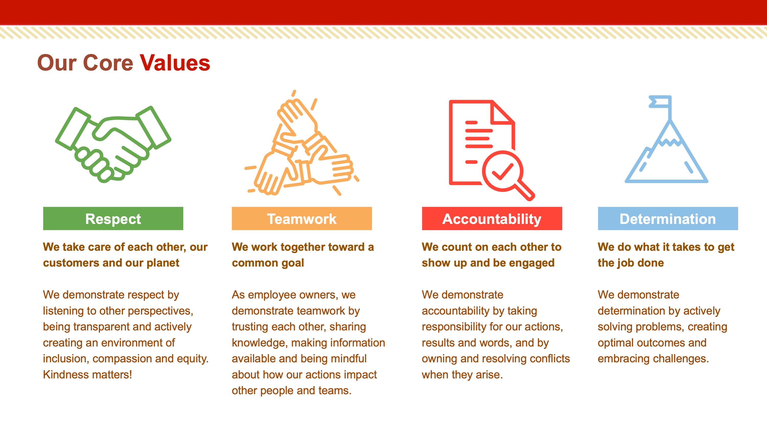

Slide 4
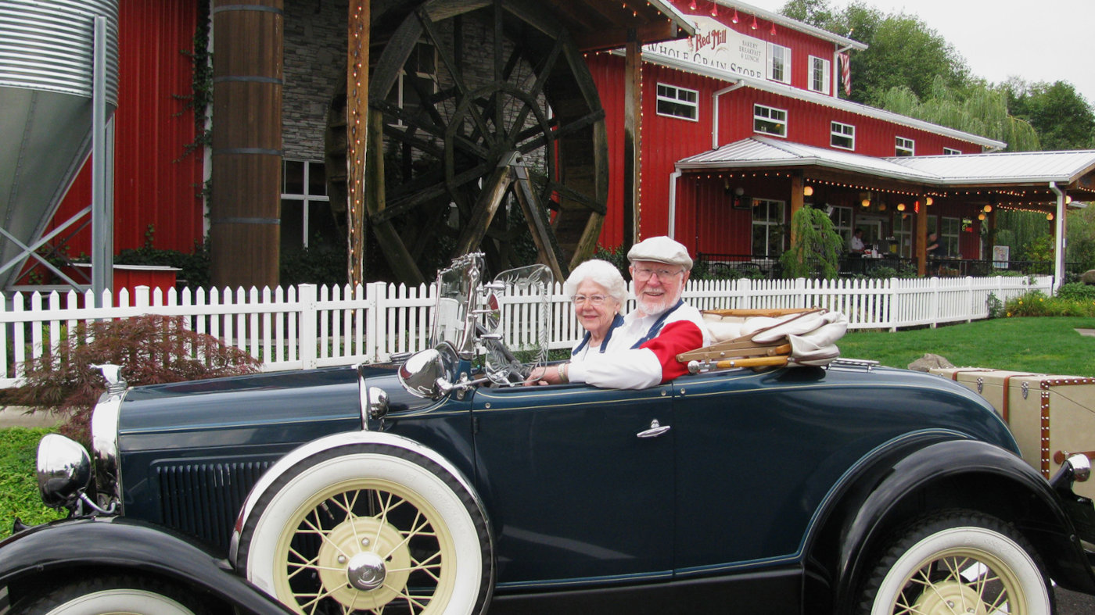

Meet Bob & Charlee
For Bob Moore, it all started with a kernel of truth—a wheat kernel, that is! Back in the 1960s, Bob’s wife, Charlee, decided she would feed her family nutritious whole grains, starting with an incredible loaf of whole wheat bread fresh from the oven.
A few years later, Bob was inspired by John Goffe’s Mill, the story of a man who—with no prior experience—resurrected his family’s ancestral mill and ground wheat into flour.
Bob’s entrepreneurial spirit was fired up! He immersed himself in the ancient art of stone milling and contacted dozens of people and companies` in his quest to locate millstones and other flour-making equipment, opening Moores’ Flour Mill in 1974 in Redding, California with Charlee and two of their sons.
My dream was to get that mill operating, and go into business with my sons, a vision similar to the dream my dad and I shared. ~ Bob
I envisioned the mill as a way to do what I wanted to do, what I believed in, which was whole grains. It was unique, it was healthy, and it fit all my aspirations for helping people. ~ Bob

Slide 5
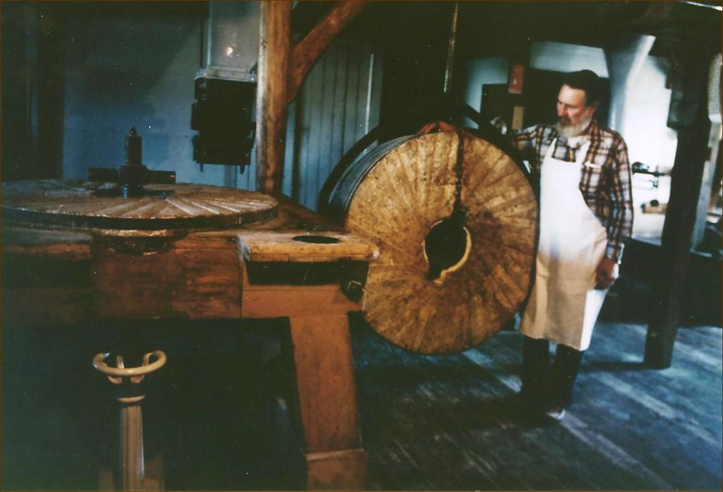
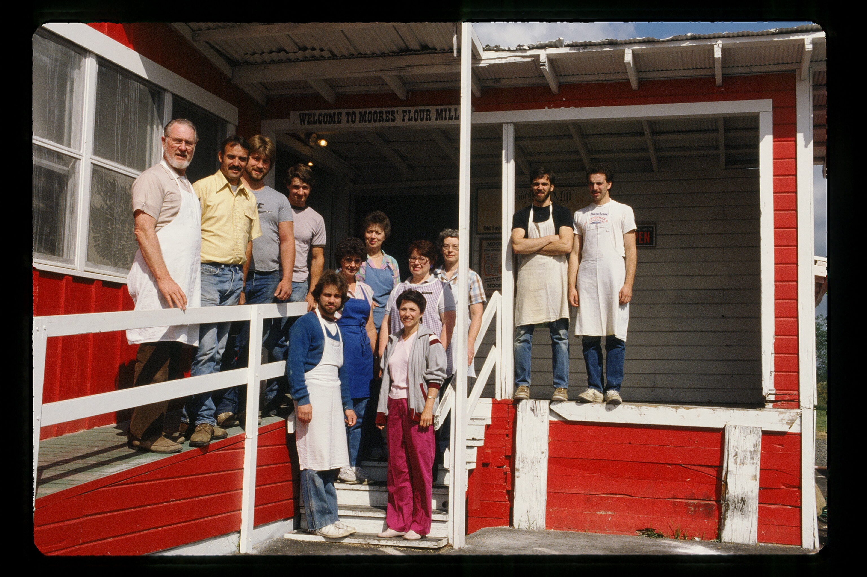
Meet Bob & Charlee
A few years later, Bob and Charlee left the mill to their sons and retired to Milwaukie, Oregon. But Bob soon learned it’s never too late to pursue a dream! After happening upon an old feed mill, he and Charlee took a leap of faith and launched Bob’s Red Mill in 1978.
It just never occurred to me that I couldn’t do it. Here’s the thing—I get a business going that I absolutely love, one that I’ve worked my whole life to get. ~ Bob
Bob’s Red Mill quickly made a splash in the burgeoning natural foods market, but soon Fred G. Meyer asked Bob to supply his Northwest grocery chain with dozens of products, introducing new customers to wholesome whole grains.
The business was a success, but a devastating fire destroyed the original mill in 1988 in a suspected arson. For many, this tragedy would have been the end of the story, but Bob’s unyielding commitment to his and Charlee’s dream made him move heaven and earth to rebuild the company in a newer, larger facility—at age 59!
As heavy as it was, and as difficult as it was, I was bound and determined to keep showing up, to keep moving forward. I just don’t know how in the heck I did it. ~ Bob
Today, Bob’s Red Mill is a worldwide brand offering more than 200 products, with more than 700 employees.

Slide 6
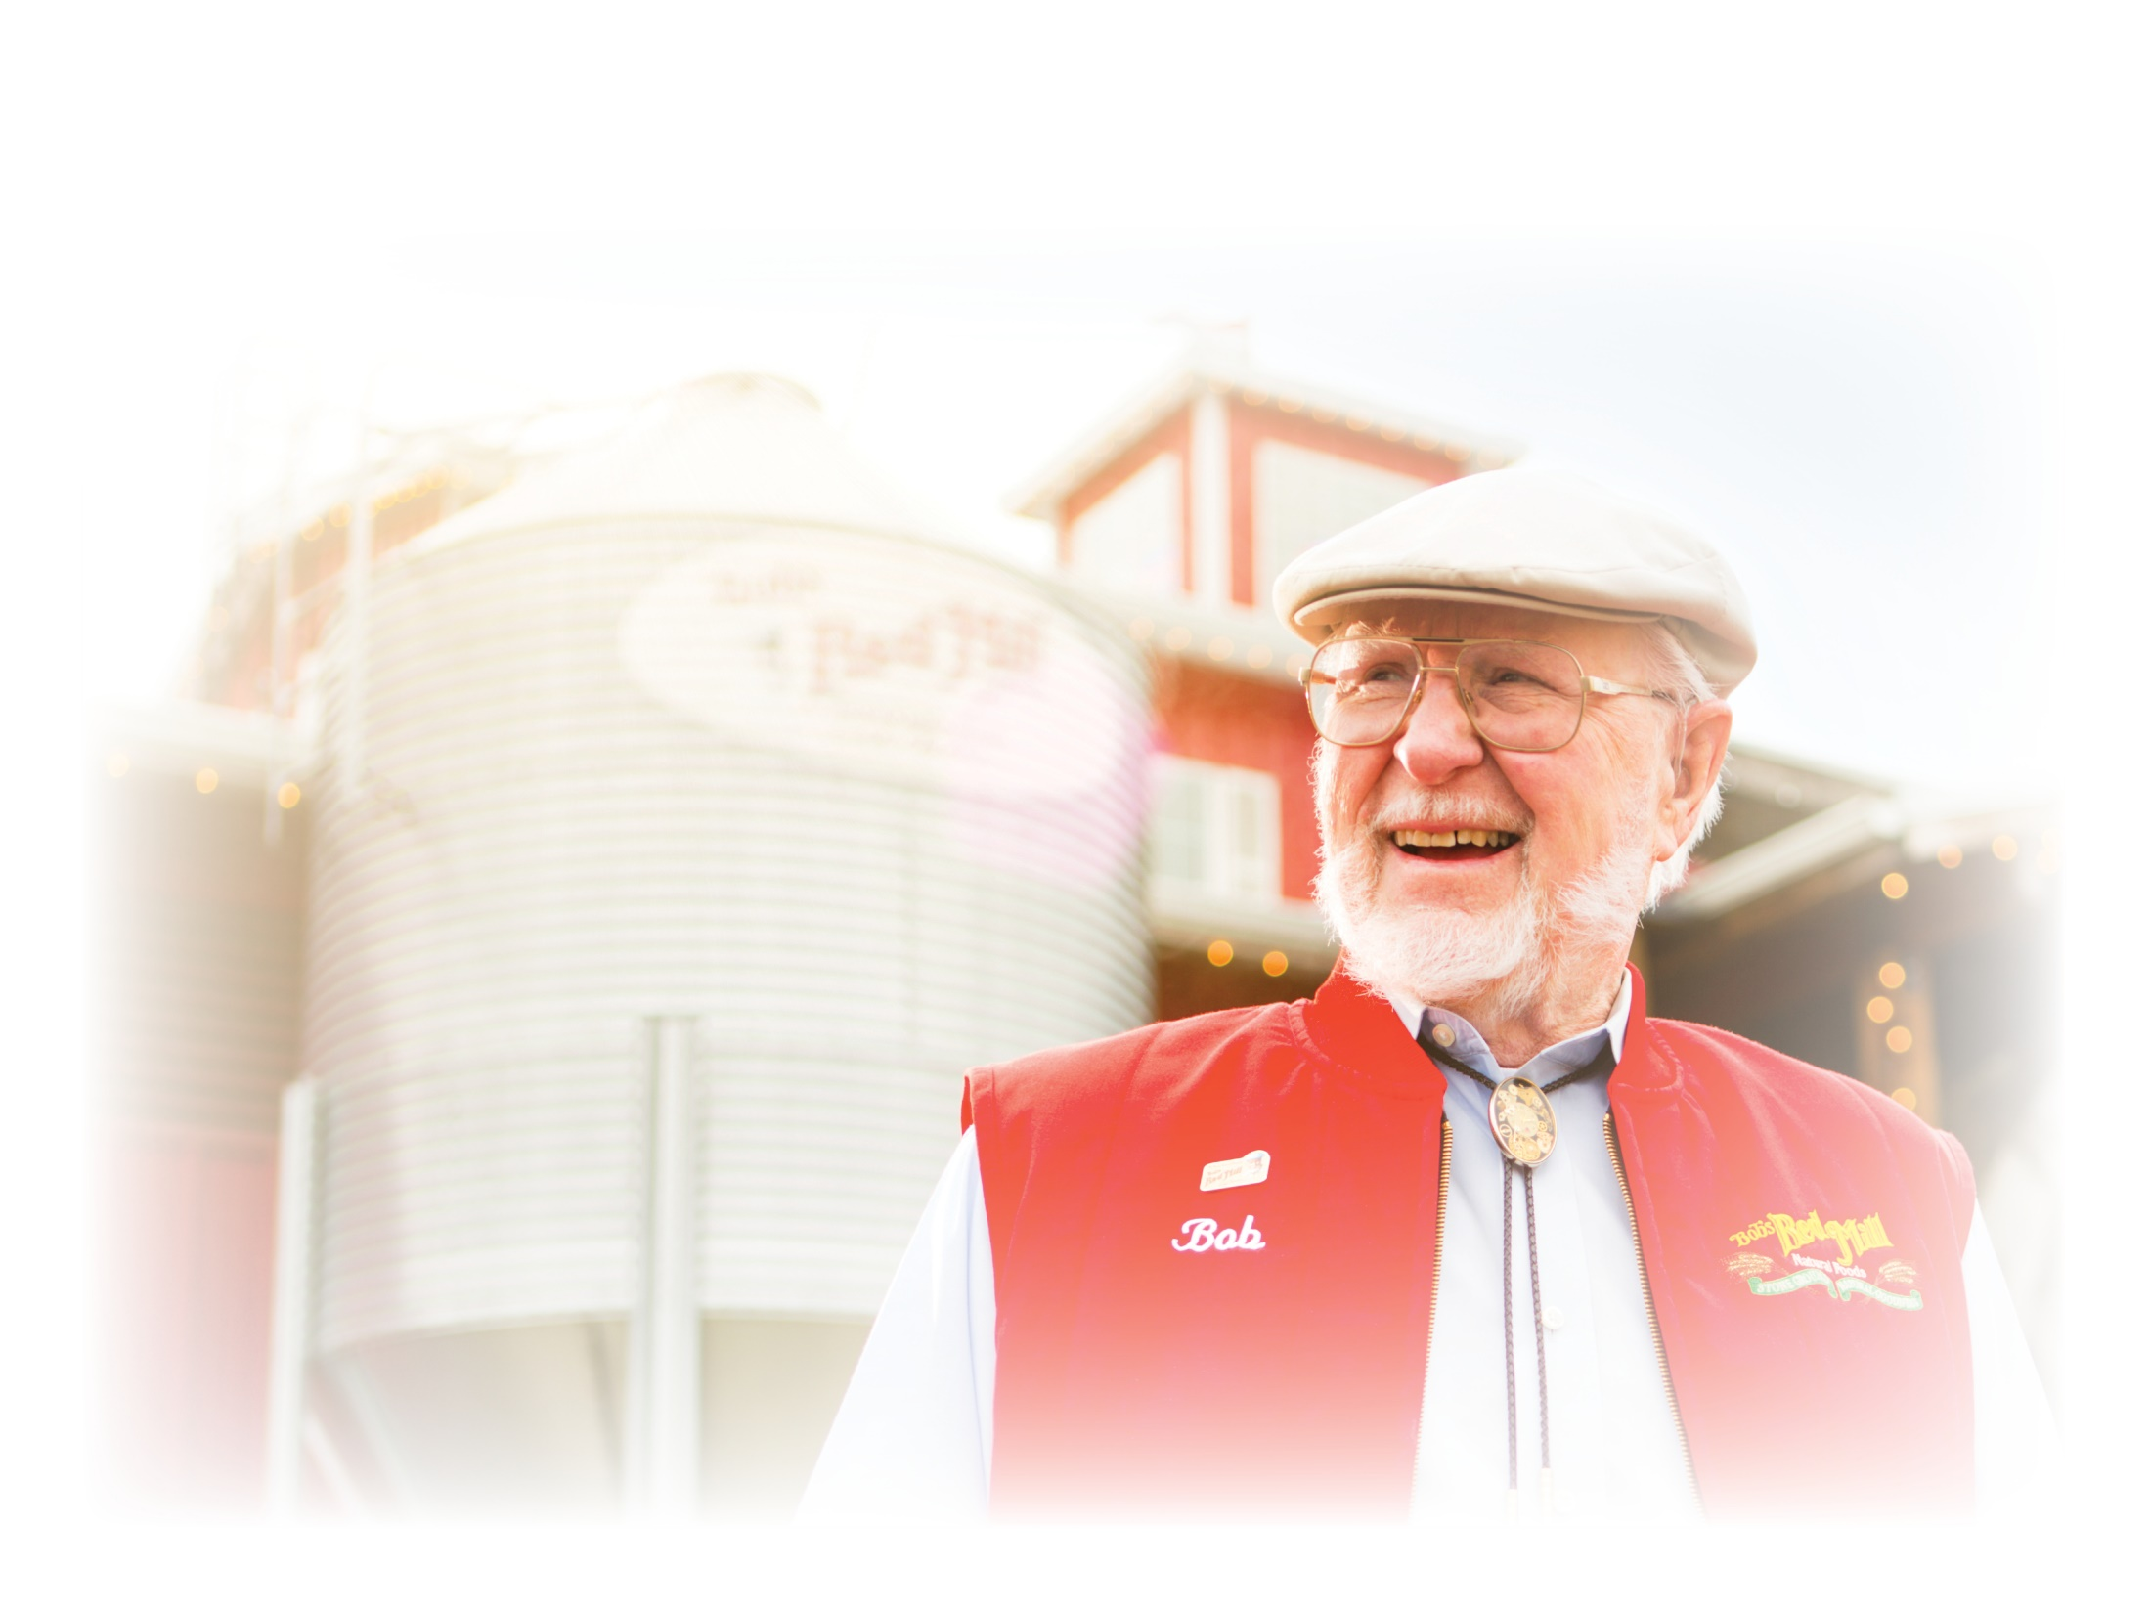
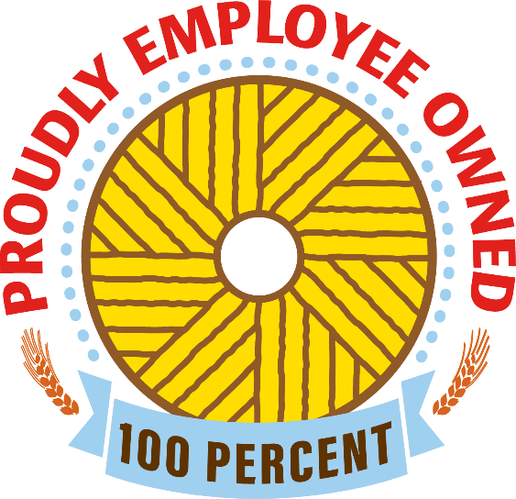
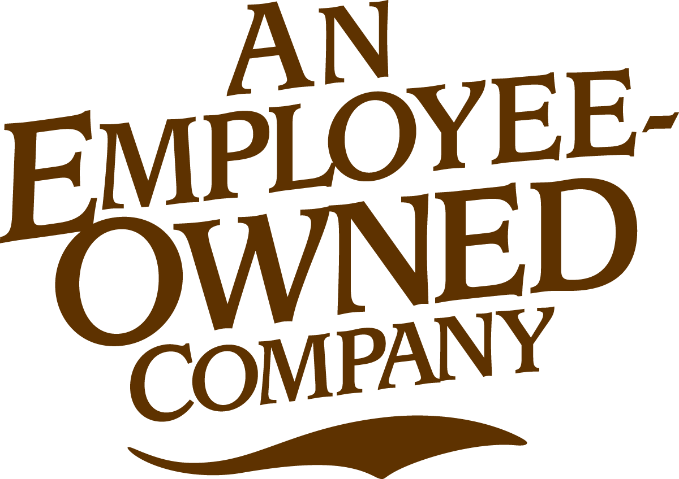
Bob's Legacy
Bob’s philosophy has always been people before profit—it’s even the title of his biography! Bob’s Red Mill was inspired by Bob’s desire to nourish people with wholesome, whole grain food, but as the company grew and expanded, he also focused on treating his employees with care and respect.
100% Employee Owned
While Bob was approached many times to sell the company, he held fast to his belief that teamwork and determination were the bedrock for a successful business, and that everyone should benefit from their hard work. So instead of selling out, he created an Employee Stock Ownership Program in 2010, making everyone an employee owner. As of 2020, we’re proudly 100% employee owned, one of only about 8,000 businesses in the country to achieve this incredible feat!
Big companies swallow little companies, and bigger companies swallow big companies. This is a love of power and money and, honestly, the best way to break out of that is to have some kind of faith that you’ll be taken care of if you work and share success with the people who make it possible. ~ Bob
Each and every one of our employee owners has a vested interest in the company. We’re in it together, and we take pride in our work as we strive to bring fresh, wholesome food to the world.

Slide 7
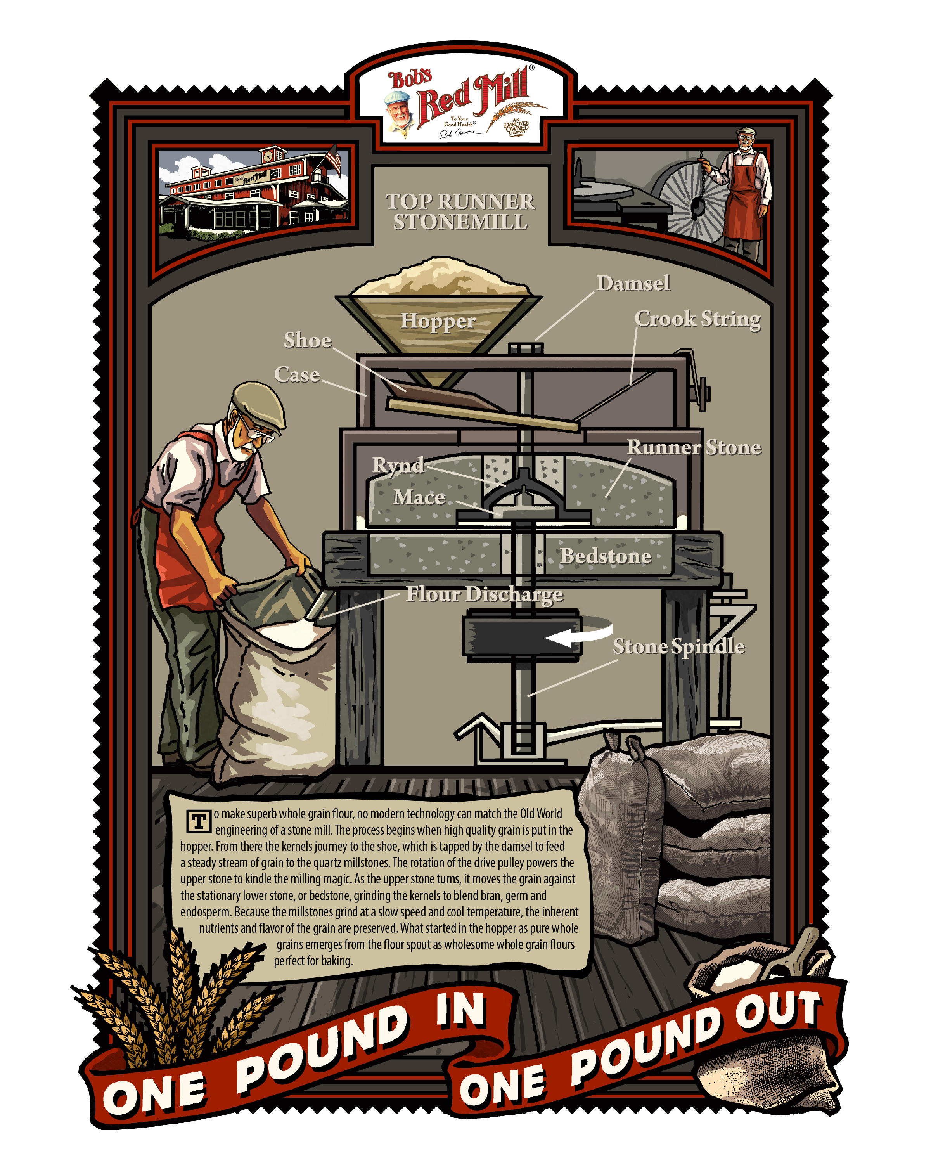
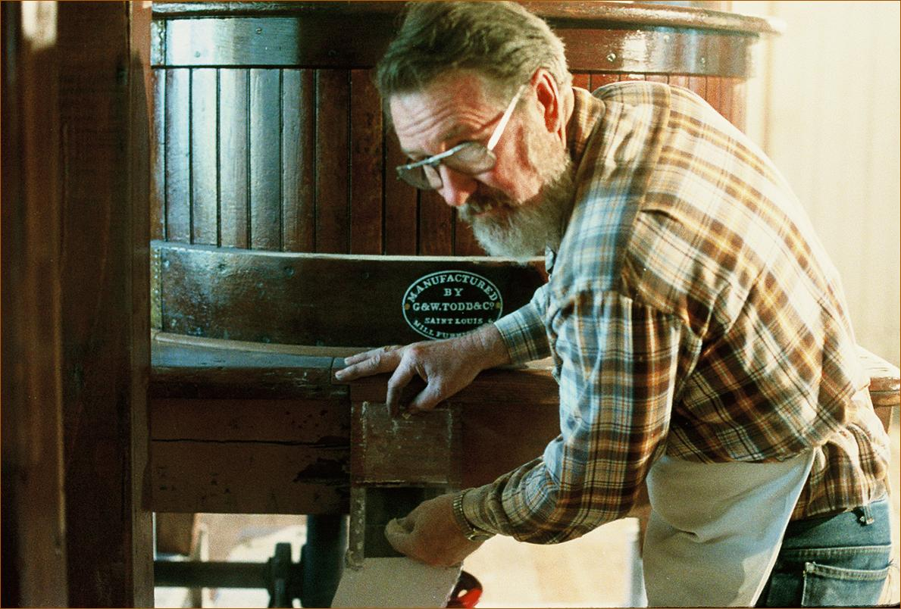
What Is Stone Milling?
“The first loaf of whole grain bread that came out of my wife Charlee’s oven on our farm back in the ‘60s was the most delicious loaf of bread I can ever remember smelling and eating.” ~ Bob
Even today, no modern technology can match the Old-World engineering of a stone mill, and our stone ground whole wheat flour is still the backbone of our company. You put one pound of grain in, and get one pound of flour out, with all the nutrition and flavor of the bran, germ and endosperm intact.

Slide 8
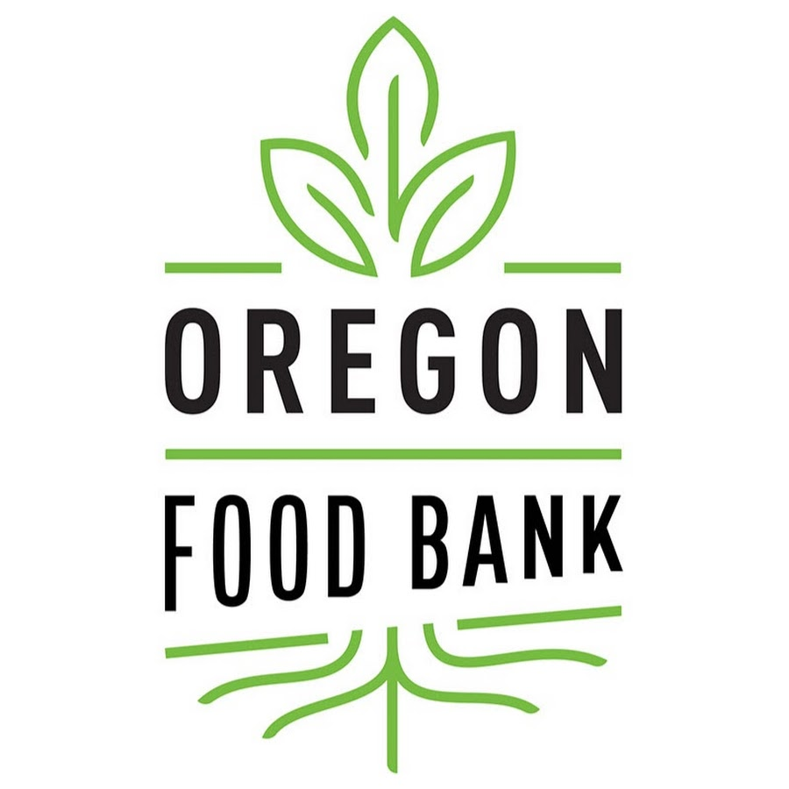
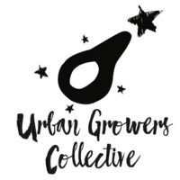

Philanthropy
Bob’s Red Mill donated $146,000 in product in 2021, which was distributed through a network of 21 regional food banks and 1,200 food assistance sites serving the state of Oregon and Clark County, Washington.
Bob’s Red Mill made nine donations of product as well as a sizeable cash donation in 2021 to support programs like COVID-19 emergency food relief and Collective Supported Agriculture. We’ve committed to monthly donations in 2022.
Bob’s Red Mill donated money as well as nine food donations in 2021 to support culinary training to refugees, asylees and survivors of human trafficking. We’ve committed to monthly donations in 2022.
Proud sponsor of Toonies for Tummies, a campaign that raises funds for Breakfast for Learning and the Breakfast Club of Canada, helping the 1 in 3 children now at risk of going to school on an empty stomach.

Slide 9
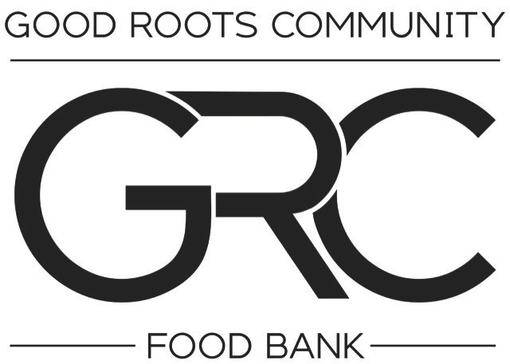
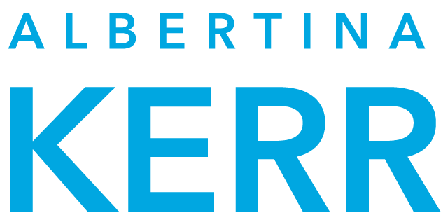
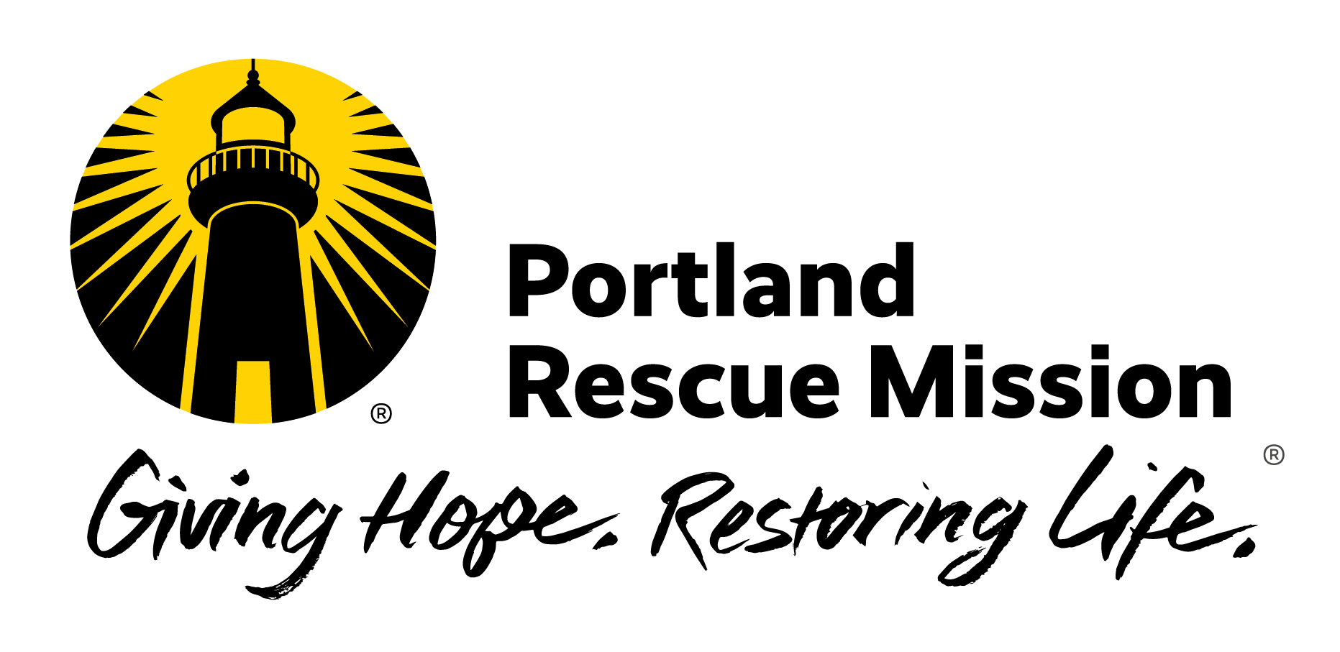
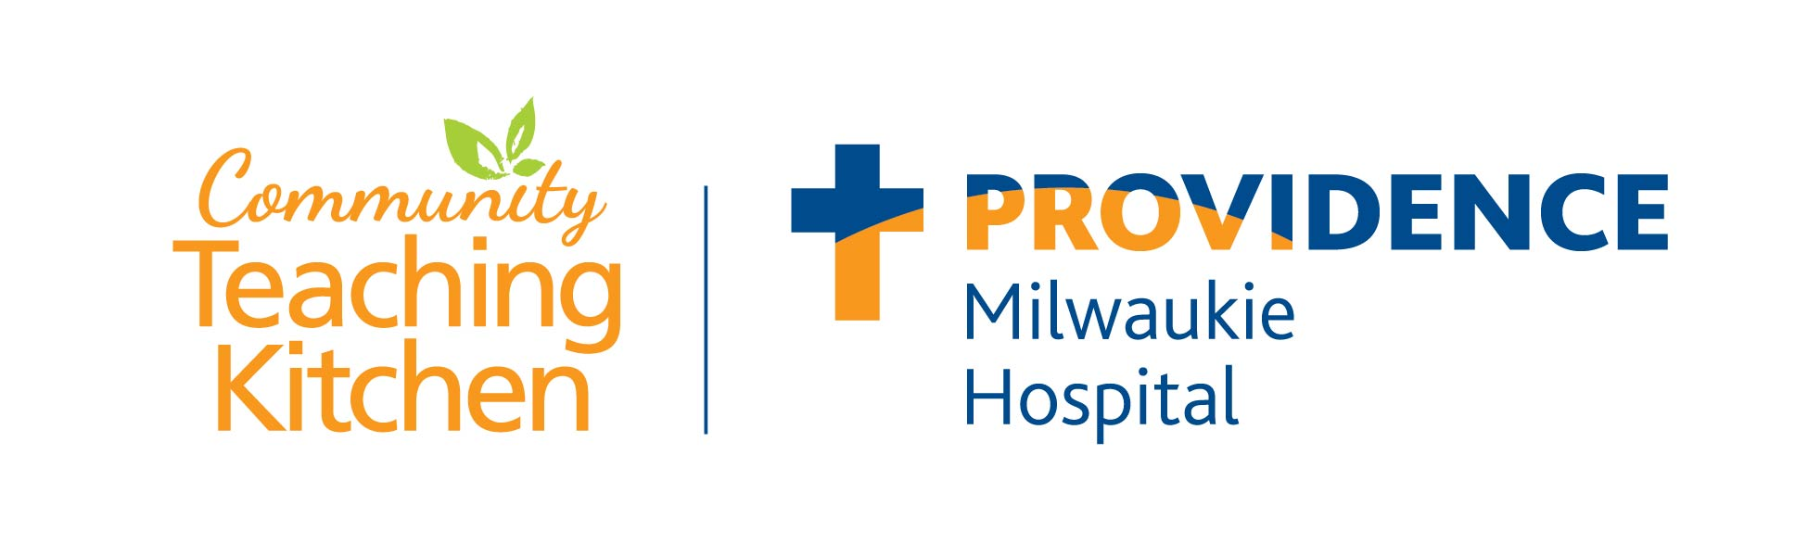
Philanthropy
Bob’s Red Mill makes regular product donations that contribute to healthy meals for the Albertina Kerr community.
Bob’s Red Mill made seven food donations in 2021 to help provide nutritious food to those in need in the Milwaukie, Oregon community.
Bob’s Red Mill helps offer hundreds of nutritious meals every day to those in need through monthly product donations in 2021 and 2022.
We are continuously making monthly product donations to assist their mission to create a healthier community through nutrition counseling, cooking lessons and access to healthy food.

Slide 10
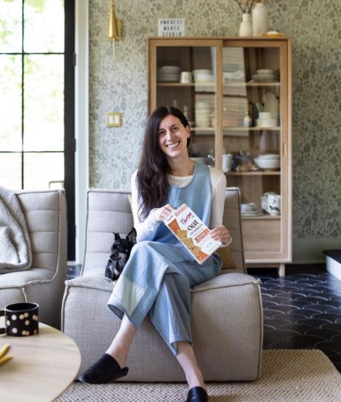
Our Customers
Who are They?
Bob’s Red Mill Attracts a Highly Desirable Customer
College Educated
Couples with & without Children
Age: 18-54
2-4 Person Household

Slide 11
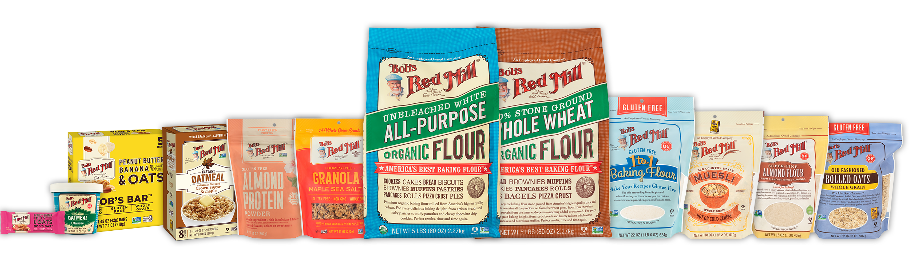
Our Customers
How are Shoppers Purchasing Bob’s Red Mill
With a high affinity for FRESH CATEGORIES, BRM brings perimeter shoppers into center store
*Shoppers have increased purchase occasions of BRM items by 5%
14.5% of households buy Bob’s Red Mill natural products, which equates to 18.3M pantries stocked
BRM shopper’s baskets are growing as BRM Shoppers spend $90 per basket and up to $140 per basket on Cereal Categories
Bob’s consumer is extremely loyal with 80%-95% on top categories
SOURCE: SPINS PANEL DATA MARCH 2022; * VS 2019

Slide 12
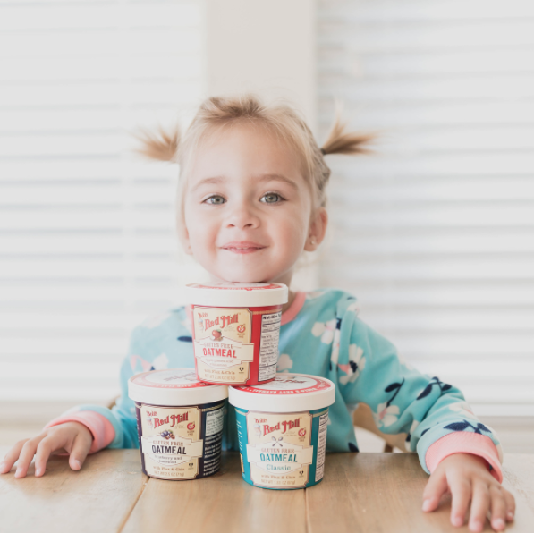
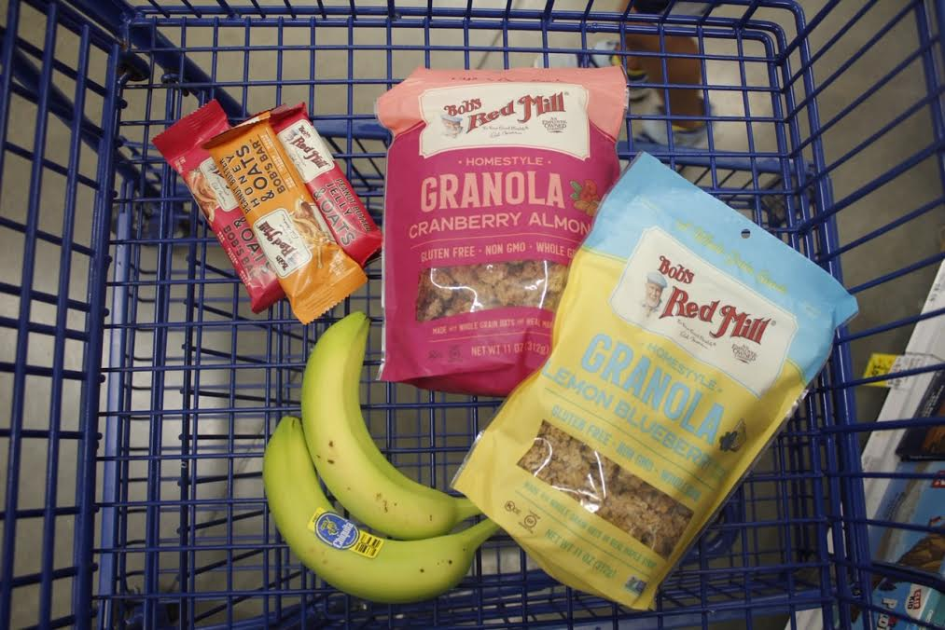
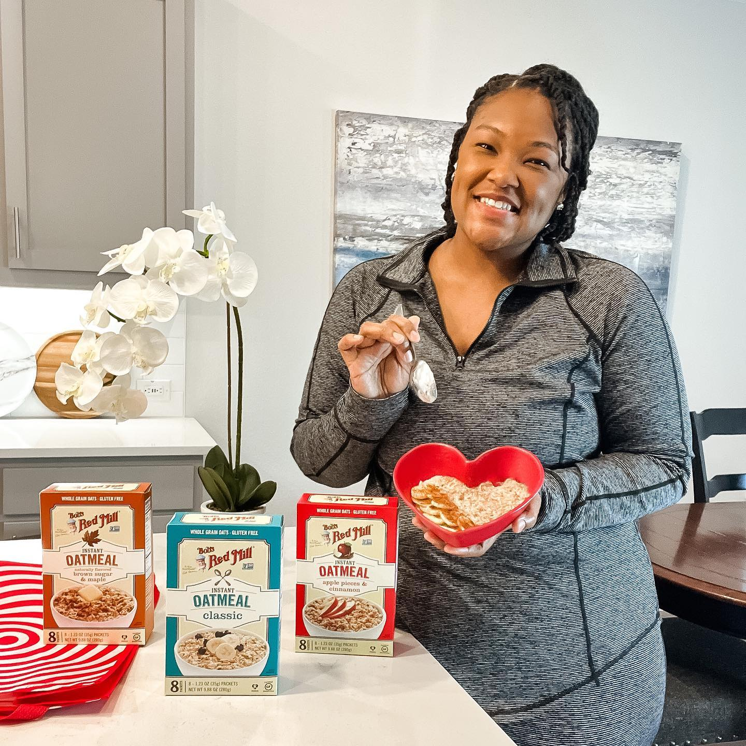
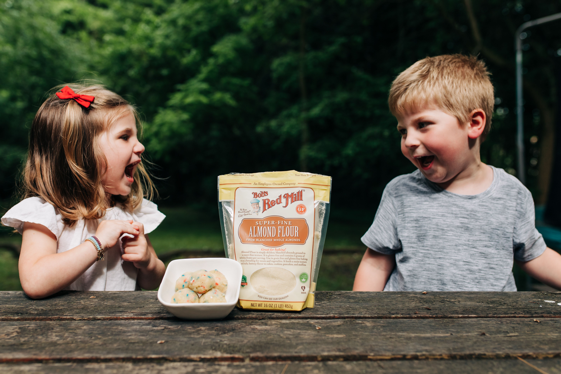
What Our Customers Have to Say
I trust Bob's Red Mill for all my kitchen staples. I have never been disappointed, and I love supporting American made high quality products that are healthy for your family. ~ Maggie R.
I just wanted to let you guys know you are doing an amazing job. I'm eating things I never thought I would again, since getting diagnosed with celiac. You guys mean the world to me, thank you! ~ Tina
I am newly diagnosed with Celiac disease and cannot eat gluten. As an avid foodie, this transition was a painfully emotional experience. Shopping and finding “safe” food was frustrating and stressful. Your products are excellent and help me live a normal life! Thank you so much! ~ Doug
I love how the convenience of your products help make eating healthy easy.
~ Anita
My personal favourite is your steel cut oats—I have them almost every day for breakfast! Thanks to everyone at Bob's Red Mill for your hard work and great products. Great to see a company based on 100% employee ownership and such strong community values! ~ Jeff

Slide 13
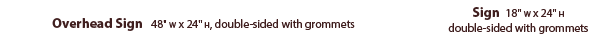
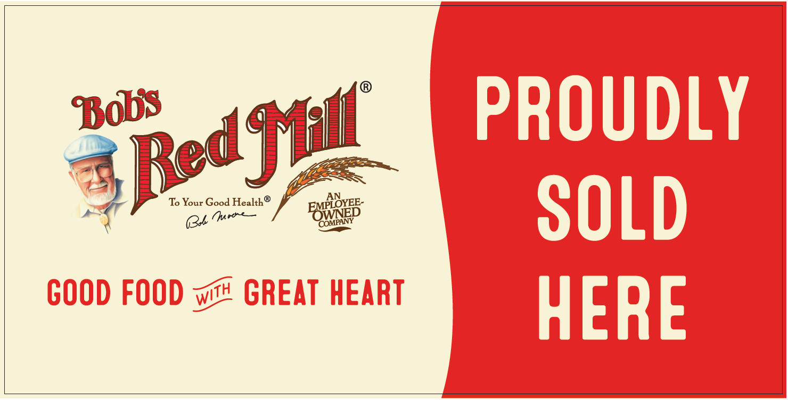
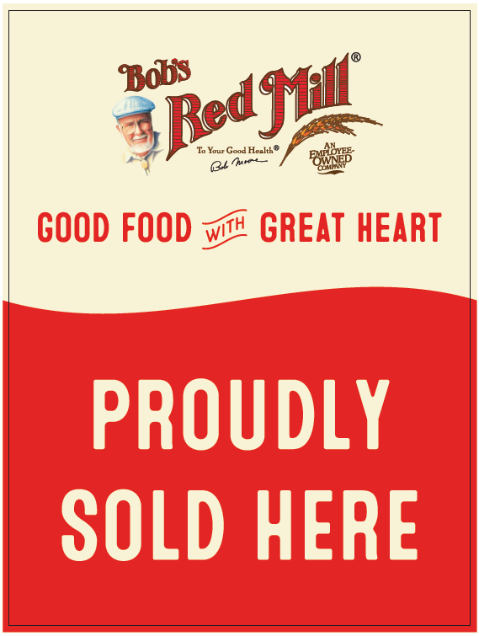
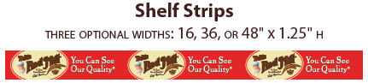
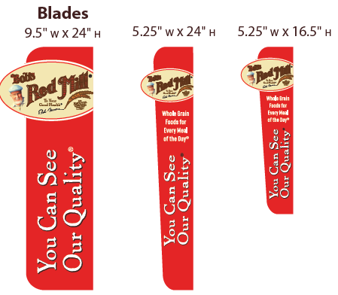
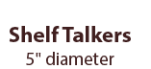
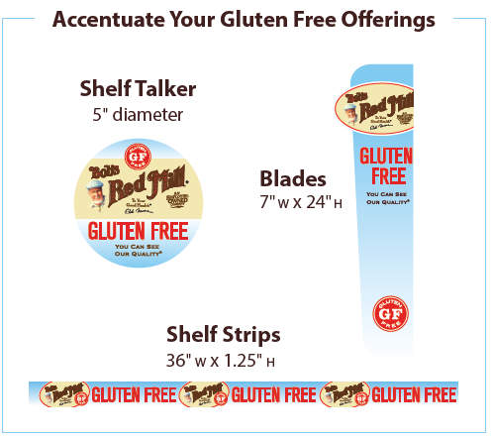
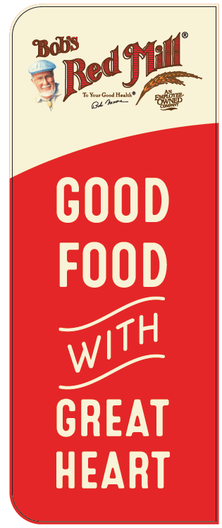
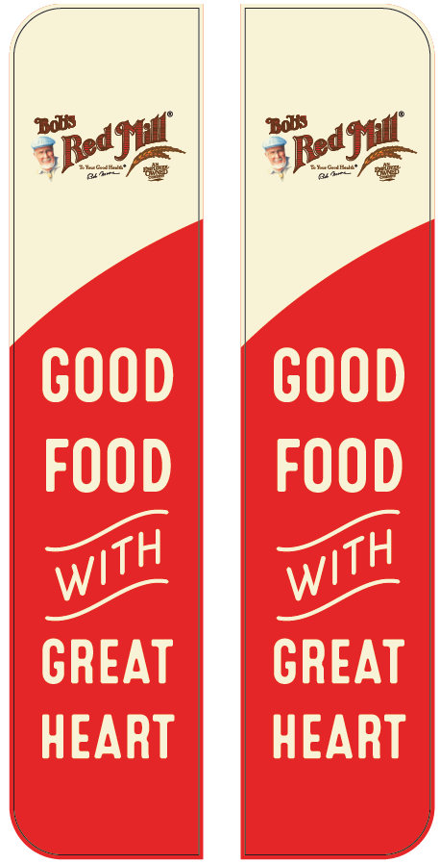
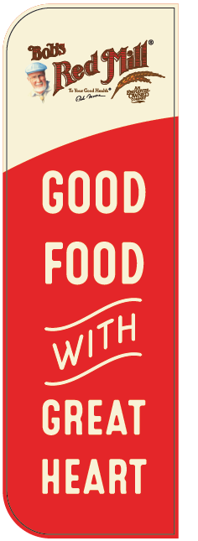
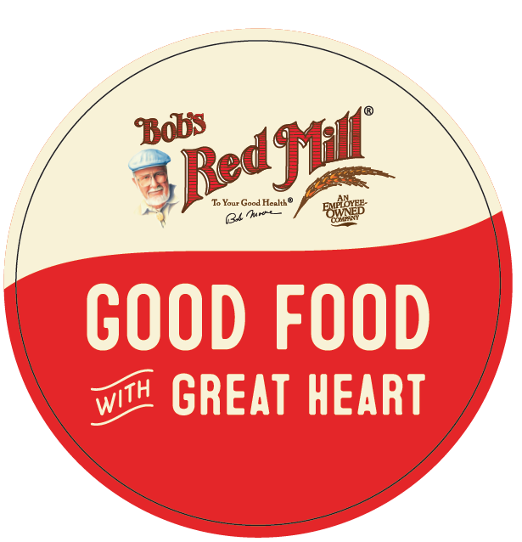
Make an Impact With Bob’s Red Mill Branding Signage
Make the Bob’s Red Mill set a healthy destination within your store! Branded signs, shelf strips and more make it easy for your customers to find the wholesome Bob’s Red Mill products they are seeking

Slide 14
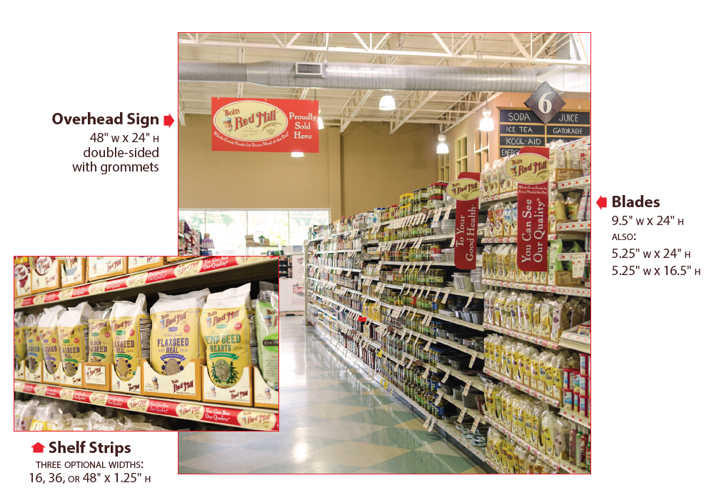
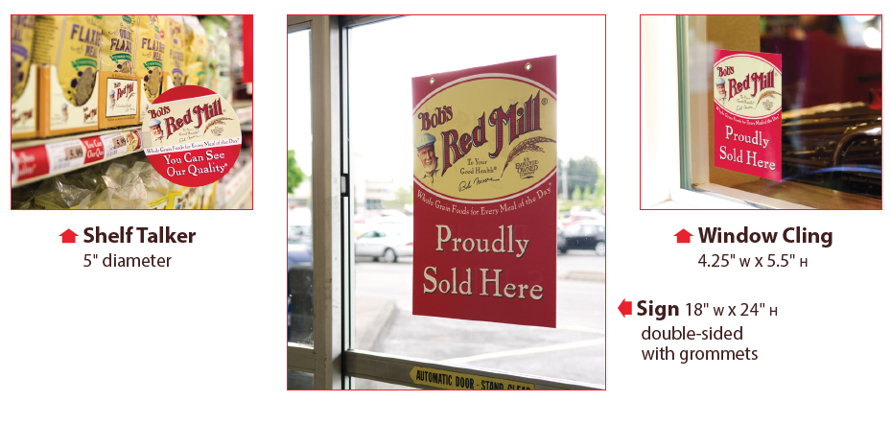
Make an Impact With Bob’s Red Mill Branding Signage
We do custom signage—contact your Bob’s Red Mill Sales Representative

Slide 15
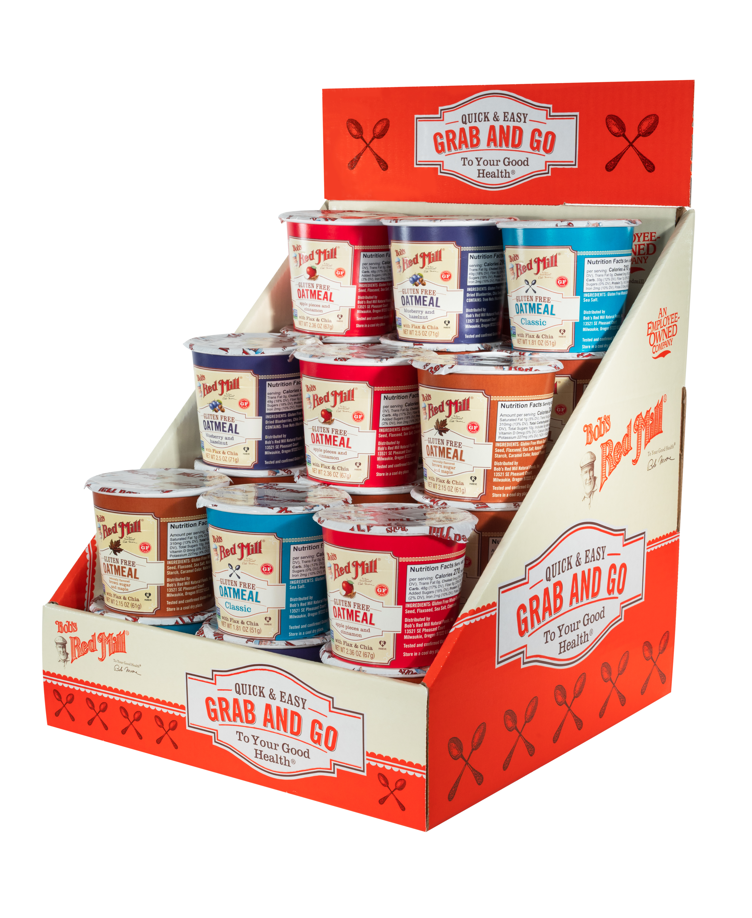
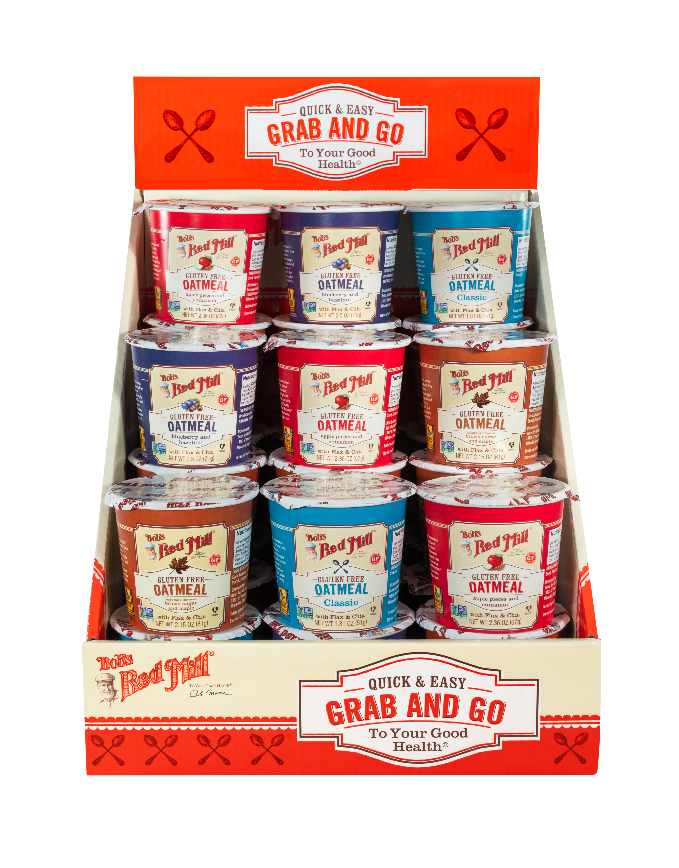
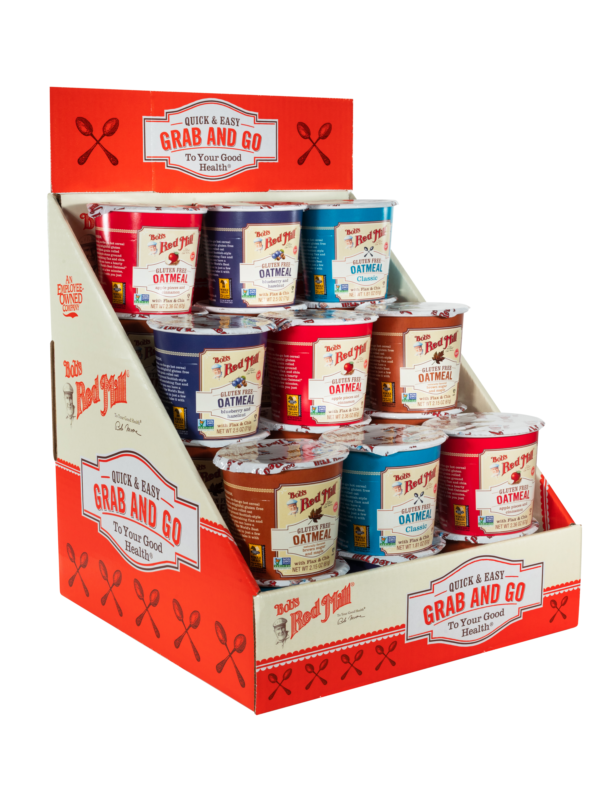
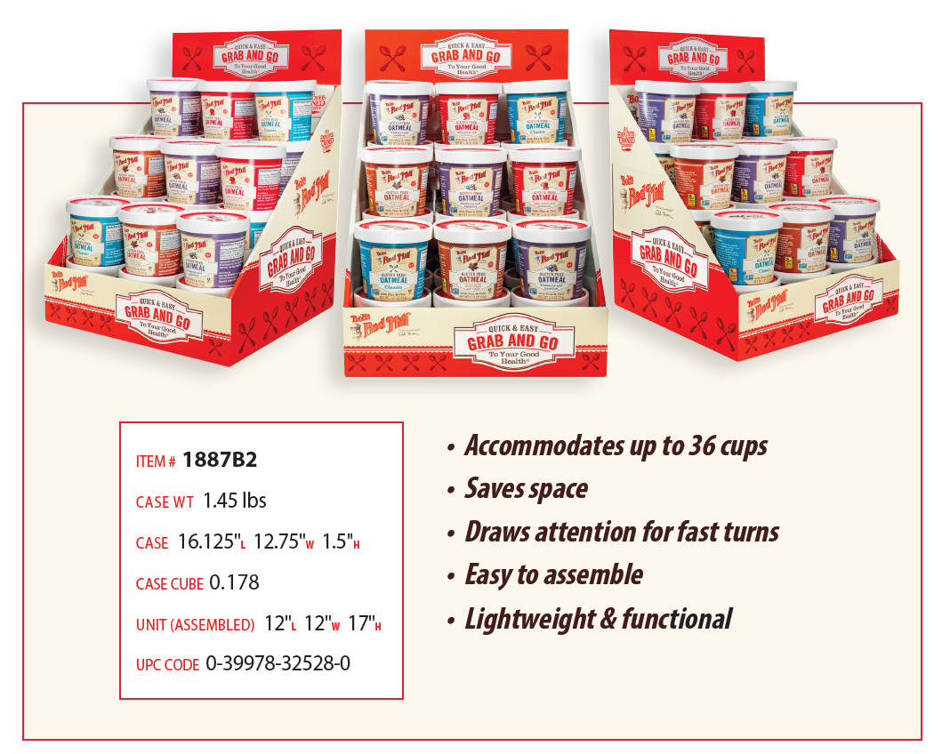

Make an Impact With Bob’s Red Mill Branding Signage
For more information and to order, contact your Bob’s Red Mill Sales Representative

Slide 16
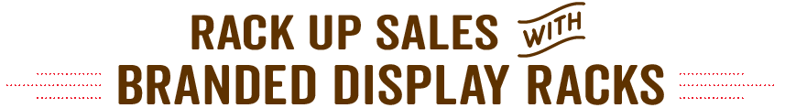
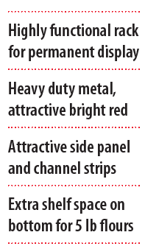
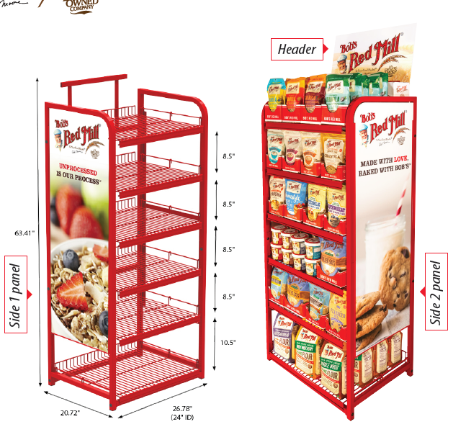
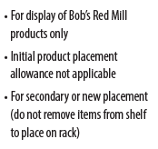

Make an Impact With Bob’s Red Mill Branding Signage

Slide 17
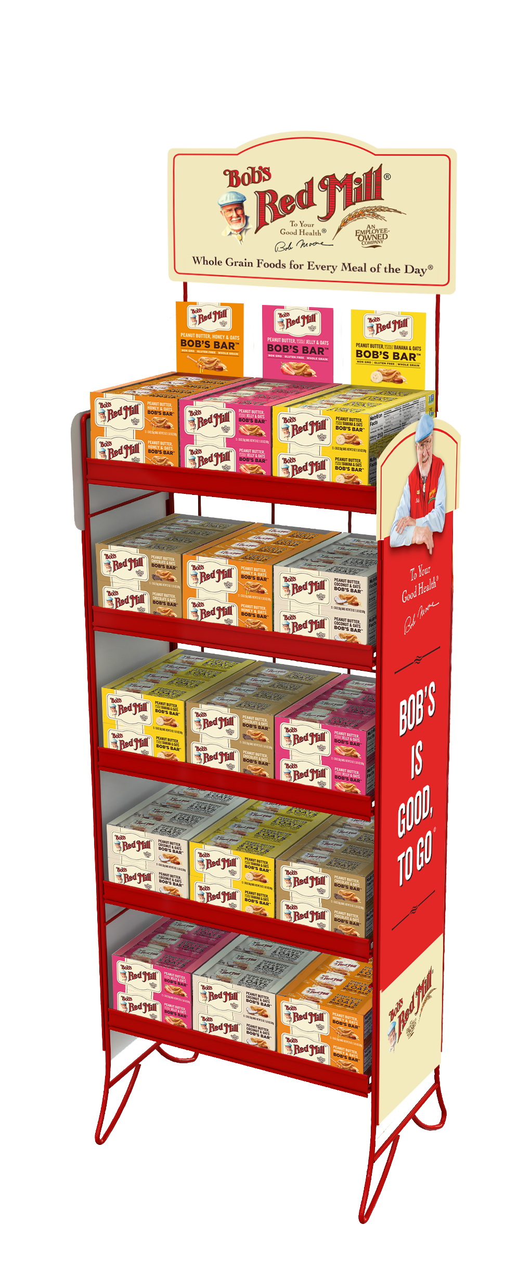
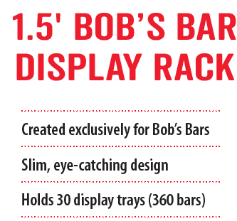
Make an Impact With Bob’s Red Mill Branding Signage

Slide 18
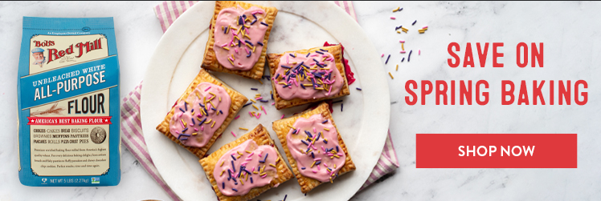
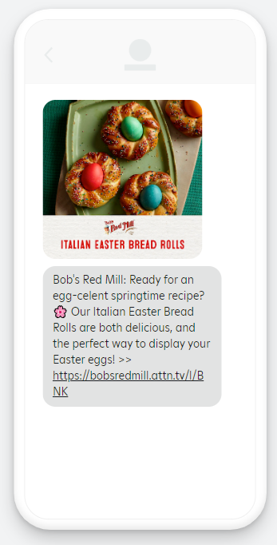


Consumer Marketing

Slide 19











Social Media
1,257,211 followers (and growing!)

Slide 20


Infrastructure Updates
Since Q2 2020, we have:
• Increased our conventional capacity by 100% and
gluten free by 40%
• Added 8 standup pouch packaging lines
• Made efficiency improvements to 3 packaging lines
• Consolidated our warehouse space into one larger
404,000 square-foot warehouse right next door to our
manufacturing plant, not only is it 164% larger than
our old warehouse, but it offers 35% more pallet
spaces This has enabled us to meet skyrocketing
demand since the pandemic!

Slide 21
Diversity, Equity & Inclusion
Bob’s Red Mill is committed to fostering, cultivating and preserving a culture of diversity, equity and inclusion. To that end, we’re hired a DEI Specialist and are focusing on the following areas.
Recruiting & Hiring
Career Development
Supplier Diversity
We recognize the value of recruiting, selecting and promoting employees with different backgrounds, knowledge, experiences, perspectives and beliefs.
Our compensation review processes actively consider equity in setting or adjusting compensation and categorizing employee roles.
Whenever possible, career development opportunities for promotion and transfer are advertised to all employees to enable individuals to further develop their own career path with Bob’s Red Mill.
All employees are required
to complete diversity and
anti-discrimination training
on an annual basis.
Our policy is to maximize vendor opportunities with minority and women-owned business enterprises (MWBEs) as suppliers, contractors and subcontractors of goods and services.
Get more details at bobsredmill.com/dei-policy
Compensation
Diversity & Respect

Slide 22




Sustainability at Bob’s
Nourishing the Planet
Solar panels saved 108 metric tons of CO2 to date—the equivalent of planting 1,792 trees
Sourcing Responsibly
50 of our products are certified organic
More than 200 of our products are Non-GMO Project Verified
Fostering Wellness
100% employee owned
385,717 pounds of food donated to food banks in 2021
We purchased 3.3 million pounds of Fair Trade CertifiedTM coconut in 2021, supporting 3,080 farmers and 41,000 acres
Awards & Partnerships
Making Food with Integrity
2021 Sustainability Excellence in Manufacturing Award – 2nd place, awarded by ProFood World
Awarded Gold by Clackamas County Leaders in Sustainability
Safe Quality Food certified, with a score of 98% in 2021

Slide 23




Flours and Non-Instant Hot Cereal
Flours
Hot Cereal
• Bob’s flour has 62.9 loyalty, on average 47% greater than competitors such
as Gold Medal & Arrowhead Mills
• Repeat buyers grew by 7.8%, outpacing competitors such as King Arthur &
Arrowhead Mills by 9.8%
• The Bob’s shopper spends up to $3.39 more than category & competitor
shoppers
• BRM shoppers spend up to 59% more than shoppers spend on the
Category & Competition
• BRM brings in $14.36 per buyer, up to $5.15 more than the Conventional
& Natural Categories & Top Competitors
• BRM drives 2.3 trips per buyer, up to 32% more trips per buyer than the
Natural Category, Quaker & Nature’s Path
SOURCE: SPINS PANEL DATA MARCH 2022

Slide 24



Bars and Instant Hot Cereal
Bob’s Bars
Instant Hot Cereal
• 30.4% of households buy natural bars, +11.3%
• Shoppers spend $6.26 on Bob’s Bars per trip, +48.8%
• 68% repeat purchase rate, +3.3%
• BRM shoppers spend 75%+ more than other shoppers
• BRM brings in $17.52 per shopper (+17.0% vs YA)
• Total basket size is $140
SOURCE: SPINS PANEL DATA MARCH 2022, VS YAGO; SHOPPER CARD DATA FROM A LEADING US RETAILER MARCH 2022

Slide 25



Quality Assurance
Safe Quality Food: Since 2018, we have been audited annually by SQF, a Food Safety Management System (FSMS), scoring consistently excellent results.
Gluten Free: Our 83,698 square-foot 100% gluten free facility adheres to industry-leading protocols, including batch testing using an ELISA Gluten Assay test. Select products certified by the Gluten-Free Certification Organization.
Kosher: All of our products are certified Kosher by OK Kosher Certification and KOF-K Kosher Certification.
Organic: We’ve been third-party certified organic by Quality Assurance International since 2002
Non-GMO Project Verified: Since 2018, more than 240 of our products have been verified with the Non-GMO Project.

